Slide 1
MINIMUM WAGE
ECONOMIC Debate

Slide 2

DEFINITION
MINIMUM WAGE- the amount of money the government states that an employee is to be paid per hour of work
PRICE FLOOR- the least amount of money that consumers can pay for a product or service offered within a particular jurisdiction.

Slide 3
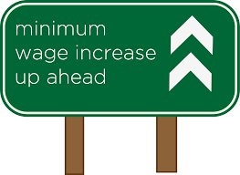
ADMINISTRATION BODIES
GOVERNMENT FEDERAL - FAIR LABOR STANDARDS ACT (FLSA)
MINISTRY- U.S DEPARTMENT OF LABOR
DIVISION- WAGE AND HOUR
Notes:
For any law to be made in the country, there must be the input of opinions from various factions in the economy. Some of the critical camps that must be consulted in the debate include economists and investors. They are the primary drivers of this topic because of the amount of money that they distribute and arbitrate through the labour force. However, the final decision lies with the federal government, and it considers other variables before the ascension of the law. Through the parliaments, the laws are tabled, discussed and passed. The role of implementing the laws lies with the department of labour facilitates the division of wage and hour to finalize the process.

Slide 4
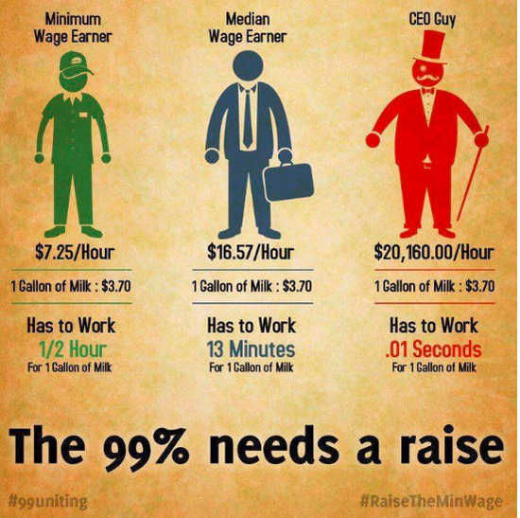
GOVERNMENT RATIONALE
Notes:
At the base of the debate are workers that seem to be struggling to meet their daily financial needs. This number appears to surpass the number of chief executive officers or the top management of numerous companies across numerous sectors. In contrast, these groups earn only two percent of senior management’s salary. In the middle of the minimum wage equation are the median wage earners that exist between the bracket of the low-income earners and top management guys, they have no direct influence on the topic, but they lose or gain financial cover when the rates are revised. The rationale of the government is then to increase wages for minimum wage earners to afford basic needs like workers in the top categories.

Slide 5
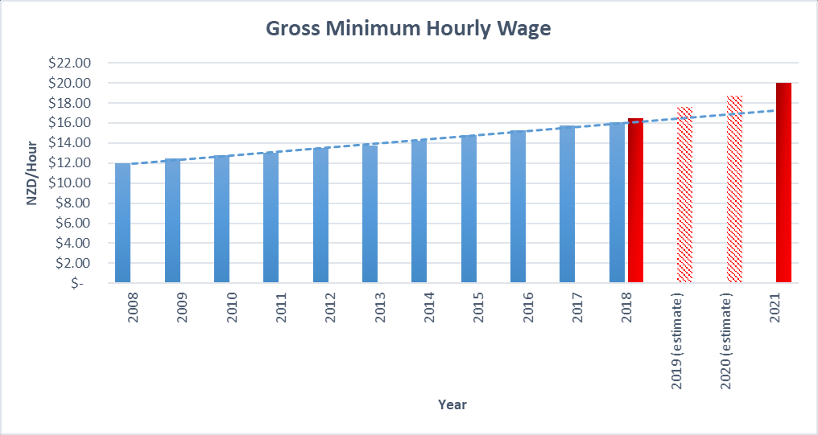
WAGE RISE OVER YEARS

Slide 6
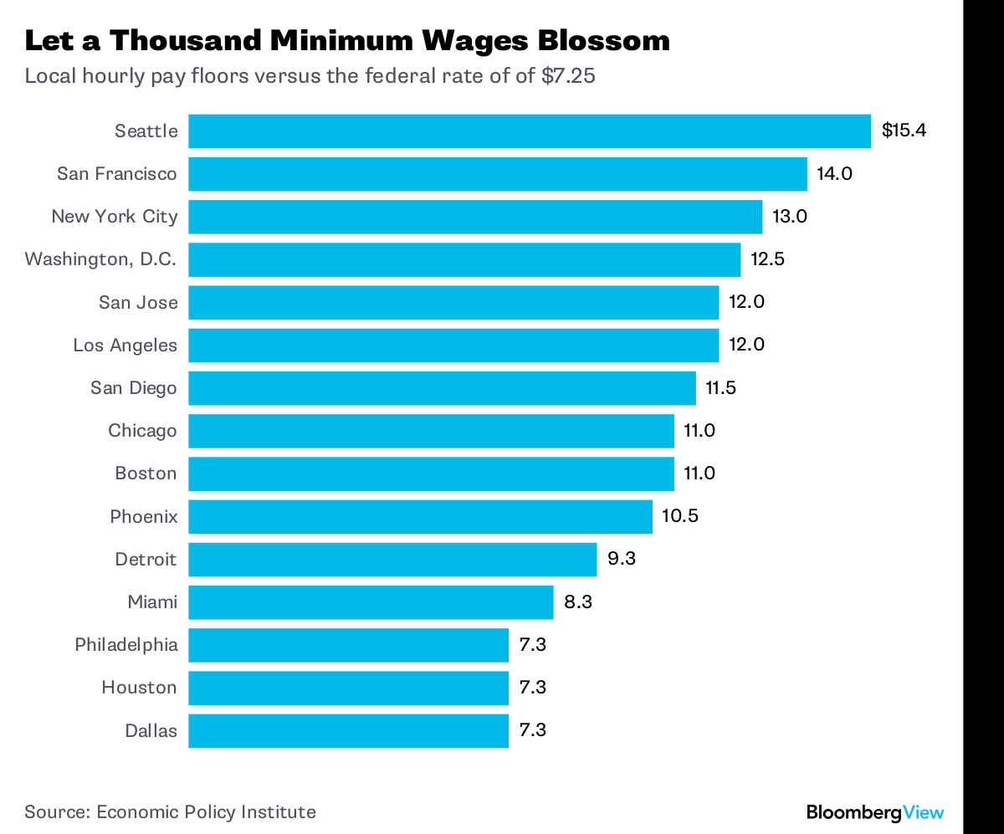
ANALYSIS ON JURISDICTION
FEDERAL WAGE RATE- $7.25 PER HOUR
STATE WAGES RATES- VARY DEPENDING ON STATE LAWS
Notes:
After the federal government settles on the price floor, the states take the mantle of adjusting the figures to ensure that they conform to their economic needs and the needs of the local workers. Various factors influence the difference in wage rates among states, and they will be discussed in the next slide. Whenever the federal government adjusts the minimum wage rate, states frantically adjust theirs to ensure they conform to the primary law. The standard rule is that the state minimum wage always surpasses the wage rate of the federal government. In that setting, Seattle tops the state minimum wage rate adjustment by capping it at $15.4 per hour.

Slide 7
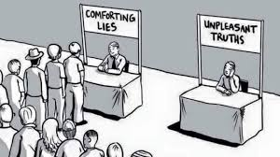
FACTORS AFFECTING WAGE RATE
EDUCATION DIFFERENTIALS
COMPENSATION DIFFERENETIALS
DISCRIMINATION DIFFERENTIALS
GEOGRAPHICAL DIFFERENTIALS
Notes:
On the scale of state minimum wage rates, Houston, Dallas and Philadelphia have the least wage rates. They cap their rates at $7.3, which is just $0.75 above the federal minimum wage rate. Factors that influence the difference of rates among states are education differentials, compensation differentials, discrimination differentials and geographical differentials. Some states have populations that have attained higher educations while others lag; the difference is evident in the number of skilled and unskilled labour. Due to historical injustices, some states are justified to increase their wages exponentially to act as compensation. Seattle uses this justification to defend its minimum wage rate rationale.

Slide 8
ADVANTAGES
MOTIVATES PEOPLE TO WORK
OFFERS JOB SECURITY
IMPROVES WORKER’S LIVING STANDARDS
FOSTERS REGIONAL AND NATIONAL ECONOMIC GROWTH
CREATES SOCIAL EQUITY
Notes:
The law has been under scrutiny since several parties have been advocating for it to be revised either upwards or downwards. Their analogy is supported by other variables that affect them directly. One party always stands against or for the idea of minimum wage rate adjustment, which is continually revised upwards. Still, the decision is made by the federal government, depending on the most urgent needs of the economy or the population. However, the most outstanding advantages are that it motivates people to work, workers get job security, living standards of the workers improve, state and federal economies grow, and social equity is guaranteed. The advantages are constant whenever the rates are adjusted upwards.

Slide 9
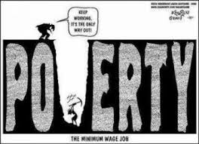
DISADVANTAGES
MUST ALWAYS RISE FOR IT TO BE BENEFICIAL
REDUCES SUSTAINABILITY OF SMALL BUSINESSES
IT DOES NOT FIX POVERTY
IT SHIFTS ECONOMIC FOUNDATIONS
DISTABILIZES THE JOB MARKET
INCREASES INFLATION
Notes:
The debate is never complete when the disadvantages of the topic are not dissected. The dissenting factors always present them, and they make sense, just like the discussed advantages. For the benefits mentioned to be achieved, the rates must always be adjusted upwards. This fact means that the disadvantages will always remain constant lest an honest discussion is initiated between the stakeholders in the economy. Small businesses that get low revenues are negatively impacted because they lack enough funds to cater for a large and skilled workforce. Their model becomes unsustainable, and this factor increases their failure rate.

Slide 10
SUPPORTING PARTIES
MINORITIES
WOMEN
YOUTH
UNSKILLED WORKERS
UNDERPAID WORKERS
Notes:
There is the analogy that the population always motivates the price floor on minimum wage. Still, studies have shown that the governments sometimes instill this notion in people, especially during campaign seasons. They color the topic and make people believe that for the quality of their lives to increase, they must receive pay rises. Among the people that are targeted during such sermons are minority groups that are always striving to compete with majority factions. The women fall under the minority group because they do not have equal opportunities, and in some sectors, they are still underpaid. The youth form a large percent of the American population, and this message resonates with their needs.

Slide 11
OPPOSING PARTIES
SMALL BUSINESSES
MICRO- ECONOMISTS
MID-SIZED COMPANIES
BIG CORPORATION
Notes:
Some of the most verbal parties against setting the price floor of minimum wages are emerging businesses because the factor complicates the development process. The financial need increase exponentially and the risk rises. Starting companies find it difficult to then get loans or investors because the risk may outweigh the returns. This fact is supported by numerous business researches done over the past ten years in America. Mid-sized companies also find it difficult to adjust their working conditions whenever the rates are revised upwards. In the end it always affects other aspects of business e.g research, operations and prices of products and services.

Slide 12

EFFECTS ON ECONOMIC VARIABLES
PRICES OF GOODS- INCREASE
INFLATION- RISES
UNEMPLOYMENT- INCREASES
INVESTMENT- DECREASES
INDIVIDUAL PROPENSITY TO SAVE- INCREASE
Notes:
The main aim of adjusting the rates is to improve the lives of the citizens and collect more taxes, for this factor to be actualized. The economic equation must be analyzed to reveal how each variable will be affected. Once people’s salaries or wages increase, then producers of goods and services are motivated to raise prices because they are sure that earning people will afford them. However, the unemployed people struggle to find money to cover the increase in prices, as the minimum wage rates are revised upwards, the unemployed dive further below the poverty line. Corporations are also forced to retrench workers for them to protect their revenue rates, and they become more cautious about their investments.

Slide 13
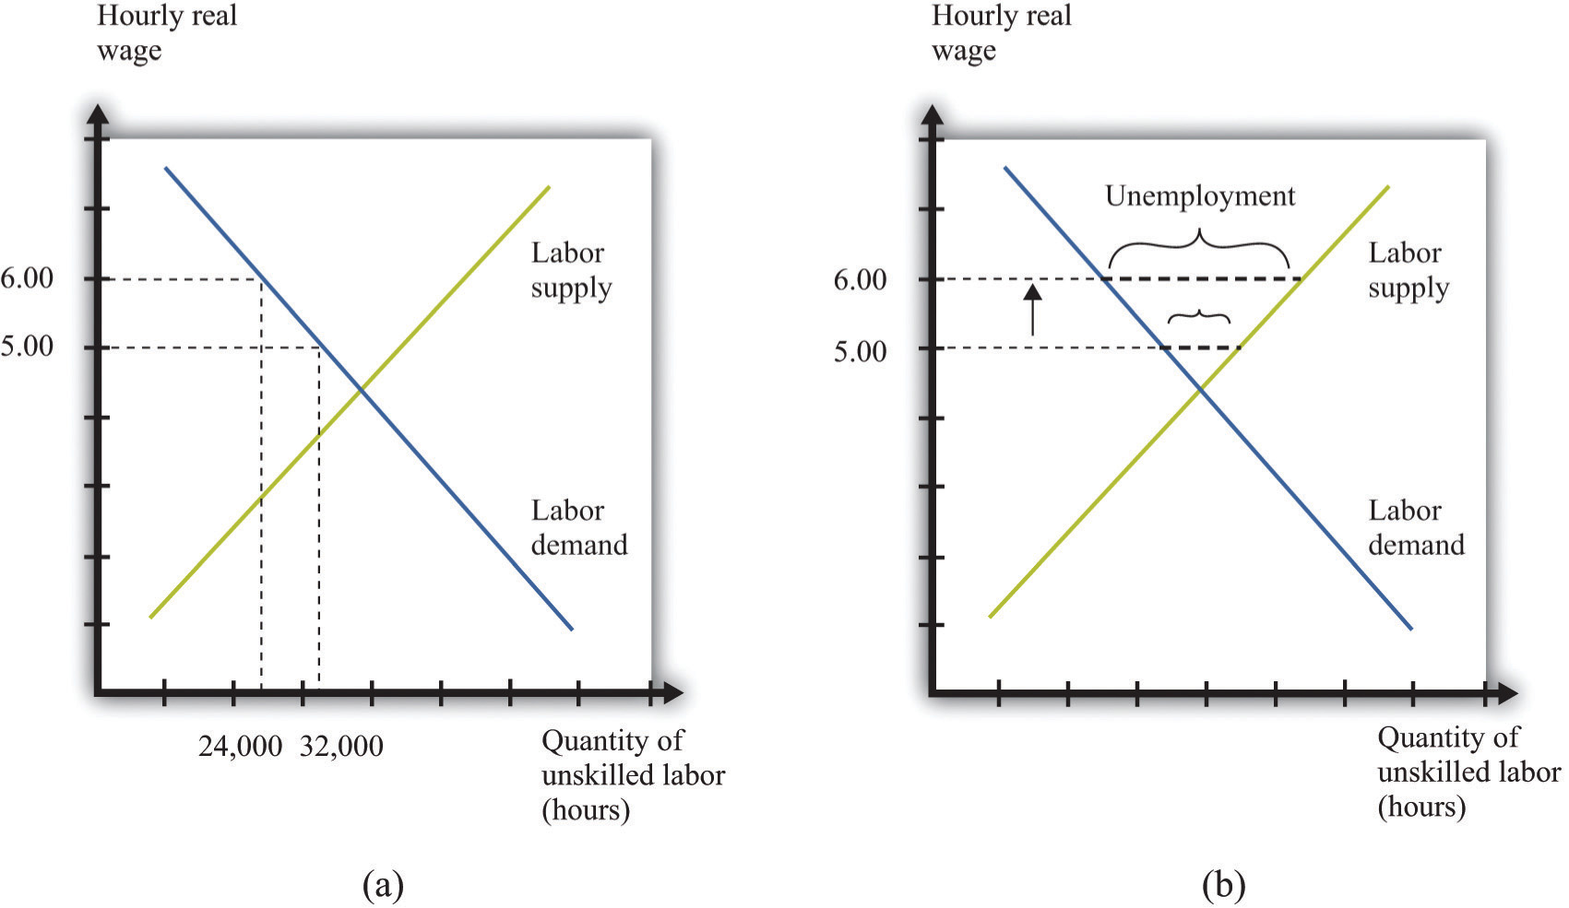
GRAPHICAL ANALYSIS
Notes:
There are two sets of people that directly affected by the upward revision of minimum wages, the skilled and unskilled people. Both of them fall under the employment variable of the economic equation because they supply the labour and determine the tax base of the federal and the state governments. During this activity, companies adjust themselves by either increasing or reducing their human capital. When wage rates rise, they lower the human capital by retrenchment, and when wage rates lower, they hire more people. In wage rate rises, the unskilled labour is reduced and exchanged for fewer skilled human capital. The result is that unemployment and poverty increases.

Slide 14
CONCLUSION
MINIMUM WAGE IS AN EXAMPLE OF PRICE FLOOR
MINIMUM WAGE IS SET BY THE FEDERAL GOVERNMENT AND ADJUSTED BY STATE GOVERNMENTS
THE RATES ARE ENFORCED BY THE U.S DEPARTMENT OF LABOR
MAIN ADVANTAGES OF MINIMUM WAGE LAWS IS JOB SECURITY AND INCREASE IN LIVING STANDARDS
MAIN DISADVANTAGES ARE LOSS OF JOBS AND REDUCTION IN INVESTMENT
THE DISADVANTAGES OF MINIMUM WAGE OUTWEIGH THE ADVANTAGES
Notes:
From the above analysis of the topic, it is clear that setting the floor price of minimum wages is detrimental to the economy and the population that lives within it. The advantages are lesser than the disadvantages and less sustainable because they thrive on the rationale of increasing wage rates. Moreover, the benefits are temporary compared to the disadvantages that last longer and are hard to recover. The employment factor seats at the middle of the equation and by extension affect the inflation of prices and the taxes that a government will collect. It is advisable that the company considers prioritizing the suggestions of the investors in the discussion because they are the primary drivers of the economy.

Slide 15
REFERENCES
Baker, D., & Strain, M. (2016). The Minimum Wage Debate.
Garnero, A., Kampelmann, S., & Rycx, F. (2015). Minimum wage systems and earnings inequalities: Does institutional diversity matter?. European Journal of Industrial Relations, 21(2), 115-130.
Murphy, J. (2017). Analyzing the Effects of Minimum Wage with Location Quotients.
Neumark, D., Salas, J. I., & Wascher, W. (2014). Revisiting the Minimum Wage—Employment Debate: Throwing Out the Baby with the Bathwater?. ILR Review, 67(3_suppl), 608-648.
Parker, J., Arrowsmith, J., Fells, R., & Prowse, P. (2016). The living wage: concepts, contexts and future concerns.
Seekings, J., & Nattrass, N. (2015). What is at issue in the minimum wage debate. Cape Town: Development Policy Research Unit, University of Cape Town.

